Slide 1

RPIF
(Roaming Problem Information Form)
Inhouse Application
Requirement

Slide 2
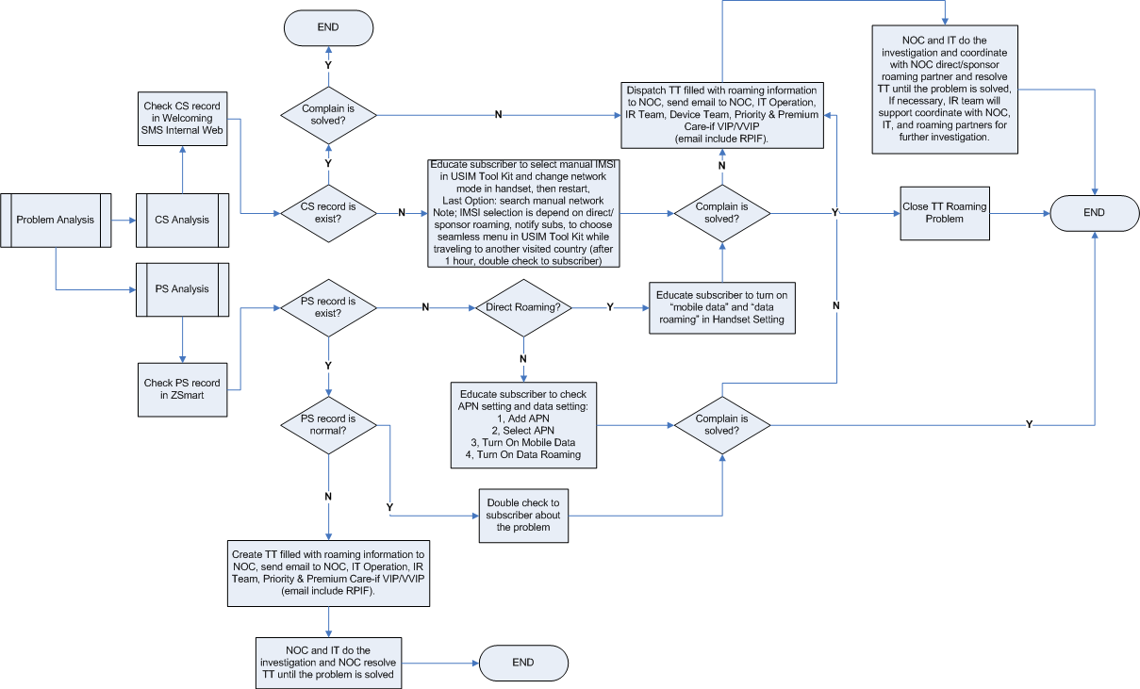
Roaming Problem Analysis Flow
Roaming Problem Analysis

Slide 3
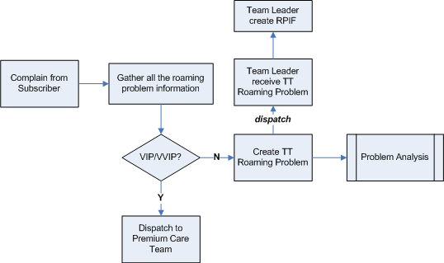
Roaming Problem Handling Flow (2)
Roaming Problem Flow for
Contact Center Inbound Regular

Slide 4
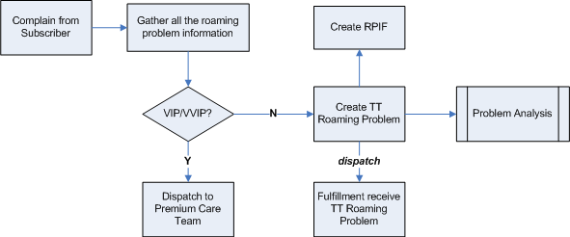
Roaming Problem Handling Flow (3)
Roaming Problem Flow for
Contact Center DTP and Corporate Care

Slide 5
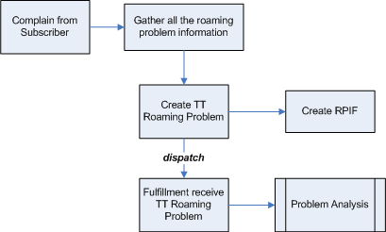
Roaming Problem Handling Flow (4)
Roaming Problem Flow for
Priority and Premium Care

Slide 6
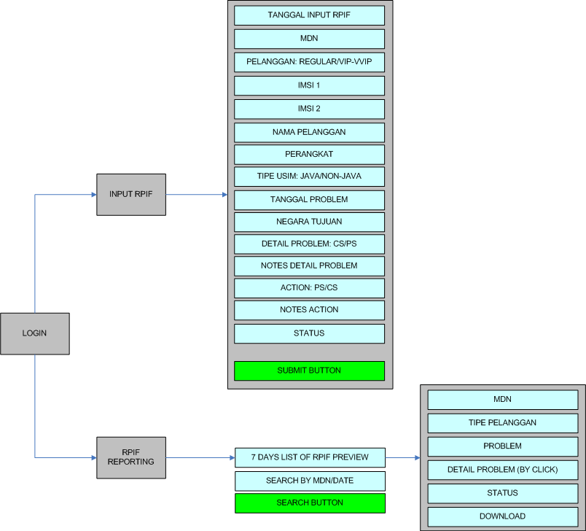
RPIF Requirement

Slide 7
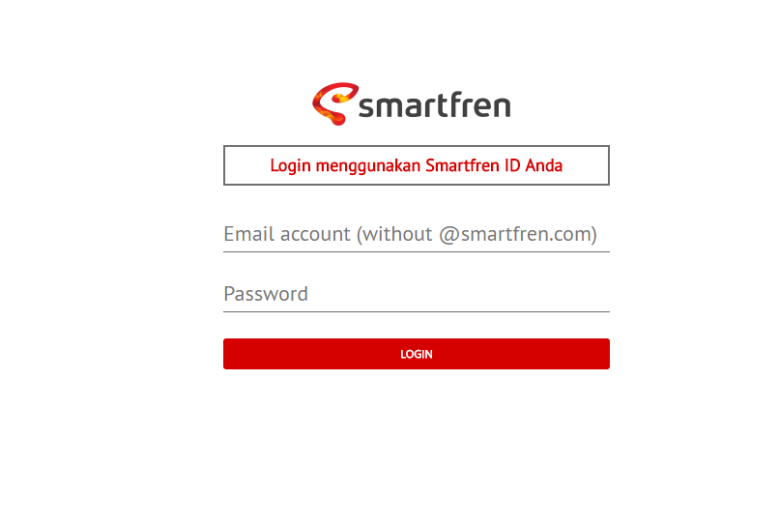
Login Page

Slide 8
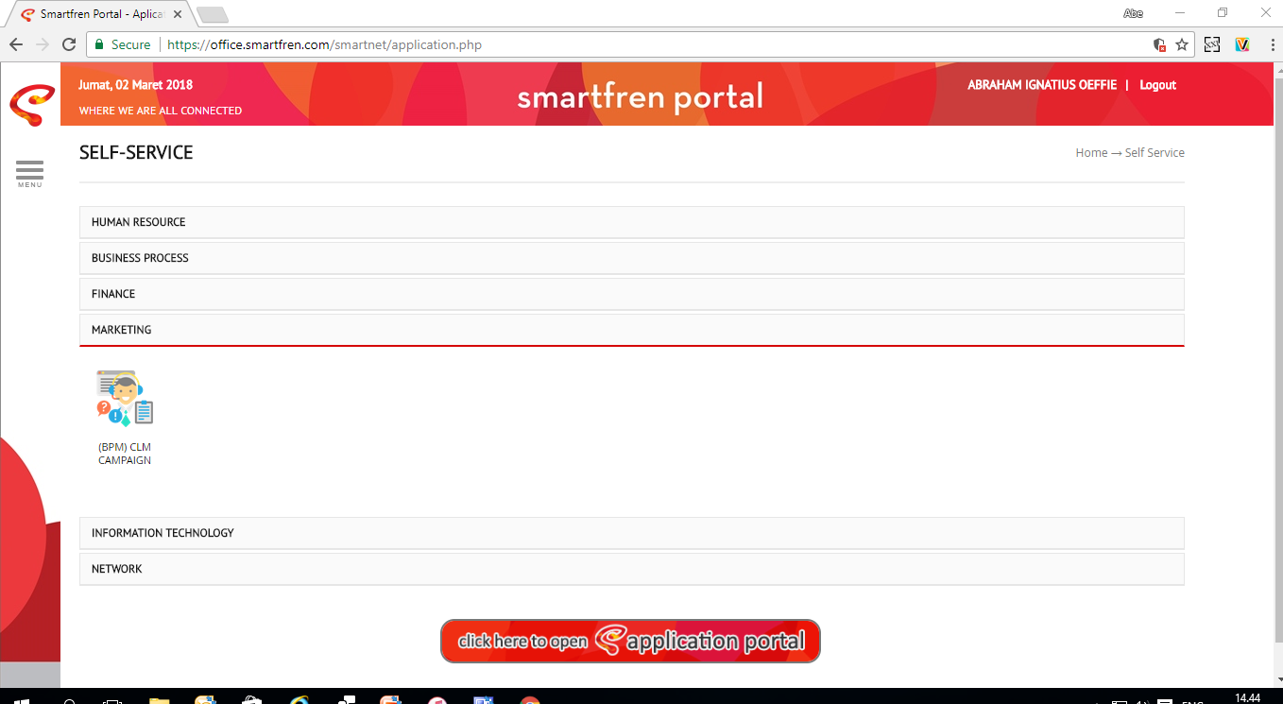

RPIF
RPIF

Slide 9
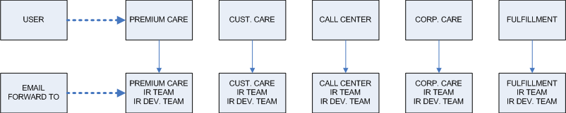
Login Page-Details
Rules for email forward:
User will able to login by registered email that requested to IT team, and password will use the existing
After user submit RPIF, then system will forward notification email to related hierarchy as picture above
List of email will be explained on the next page

Slide 10
Email Forward Template
Roaming Problem Information
RPIF@smartfren.com
Sent : Rab 14/02/2018 12.02
To : Premiumcare@smartfren.com
CC : abe.oeffie@smartfren.com; sinarojo.tantoko@smartfren.com; stefani.jonsant@smartfren.com
Dear All,
Please find new RPIF as mentioned below:
Regards,
RPIF System
NO. | MDN | NAMA PELANGGAN | IMSI 1 | IMSI 2 | TYPE PELANGGAN | TIPE USIM | NEGARA TUJUAN | JENIS PROBLEM | STATUS
1 | 8811211470 | Abe Oeffie | 510098441345214 | 525053441345214 | Regular | Java | Singapore | CS-PS | ongoing

Slide 11
List Email (1)-User Login
NO. | DEPT. | EMAIL
1 | Premium Care | Attached
2 | Cust. Care | Attached
3 | Fulfillment | Attached
4 | Call Center | Attached

Slide 12
List Email (2)-Forward RPIF
NO. | DEPT. | EMAIL
1 | Premium Care | attached
2 | Cust. Care | attached
3 | Fulfillment | attached
4 | Call Center | attached
5 | IR Team | attached
6 | IR Dev. Team | attached
7 | IR Commercial Team | attached

Slide 13
HOME
Input Form
Klik untuk masuk ke menu Input Form
RPIF Reporting
Klik untuk masuk ke menu RPIF Reporting

Slide 14
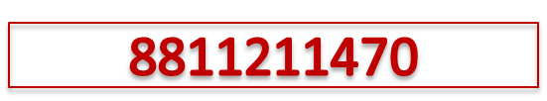

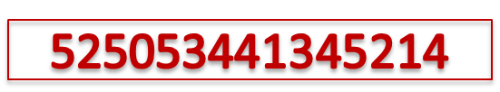
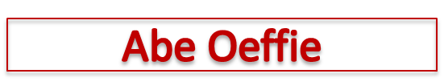
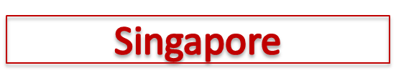

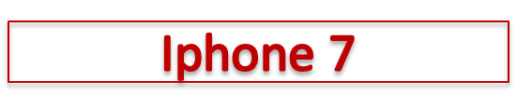



Input RPIF
ROAMING PROBLEM INFORMATION FORM
MDN
13 February 2018
Tipe Pelanggan
Regular
√
VIP/VVIP
IMSI 1
IMSI 2
Nama Pelanggan
Tipe USIM
Java
√
Non Java
Negara Tujuan
Tanggal Problem
Tipe Perangkat
Jenis Problem
√
√
CS
PS
Detail Problem
√
√
Action
CS
PS
Detail Action
Status Problem
SUBMIT

Slide 15





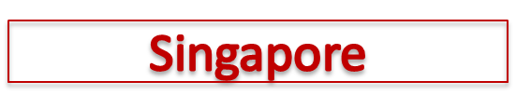






Input RPIF-After Submit
ROAMING PROBLEM INFORMATION FORM
MDN
13 February 2018
Tipe Pelanggan
Regular
√
VIP/VVIP
IMSI 1
Pop up after
click Submit Button
TERIMA KASIH
Anda telah melakukan input RPIF
Reminder :
√ Silahkan melakukan pembuatan Trouble Ticket jika problem belum ada solusi
√ Mohon lakukan update status RPIF jika problem sudah ada solusi
IMSI 2
Nama Pelanggan
Tipe USIM
Java
√
Non Java
Negara Tujuan
Tanggal Problem
Jenis Problem
√
√
CS
PS
Detail Problem
√
√
DONE
Back to home
Action
CS
PS
Detail Action
Status Problem
SUBMIT

Slide 16
Input RPIF-Details
Input Field
MDN : input by user with format without “0”
Tipe Pelanggan : input by user by clicking the check box (only one check box can be filled)
IMSI 1 : input by user with format 51009 or 51028 as 5 first digit
IMSI 2 : input by user with format 52505 as 5 first digit
Nama Pelanggan : input by user
Tipe USIM : input by user by clicking the check box (only one check box can be filled)
Negara Tujuan : input by user
Tipe Perangkat : input by user
Jenis Problem : input by user by clicking the check box (max. 2 check box can be filled)
Detail Problem : input by user
Action : input by user by clicking the check box (max. 2 check box can be filled)
Detail Action : input by user
Status Problem : input by user by choosing the drop down: ongoing/solved(only one drop down can be choosed)
Tanggal Problem : input by user (calendar required)
Tanggal Input : today’s date, automatically showed by system
Submit Button :
  Only can be clicked after all input field is fully filled by user
  This button will keep the RPIF form to database and can be called again in RPIF reporting menu
  After click this button (only for the first time), system automatically will forward email to related department

Slide 17
RPIF Reporting-Search
Input field to search by MDN, Name, Tanggal Problem
RPIF Reporting
<MDN/ Name /Tanggal Problem>
8811211470 : CS-PS, Abe Oeffie, 12-02-12018
8811211234 : CS-PS, Junaedi, 13-02-2018
8811211235 : CS-PS, Zubaedah, 13-02-2018
Highlight to preview all complains by last 7 days
Preview last 7 days complain:
MDN
Jenis Problem
Nama Pelanggan
Tanggal Problem
BACK TO MENU

Slide 18
RPIF Reporting-Search Result
RPIF Reporting 13 February 2018
Problem’s date, query by search menu
NO. | MDN | NAMA PELANGGAN | IMSI 1 | IMSI 2 | TYPE PELANGGAN | TIPE USIM | NEGARA TUJUAN | JENIS PROBLEM | STATUS
1 | 8811211470 | Abe Oeffie | 510098441345214 | 525053441345214 | Regular | Java | Singapore | CS-PS | ongoing
2 | 8811211234 | Junaedi | 510098441567812 | 525053441567812 | VIP-VVIP | Java | Spain | CS-PS | ongoing
2 | 8811211235 | Zubaedah | 510098441567123 | 525053441567123 | Regular | Java | Hong Kong | CS-PS | Solved download
Clickable and will forward to “Input RPIF form” page
Download menu with excel format
BACK TO MENU

Slide 19
THANK YOU

